Slide 1

RIDGE & LASSO REGRESSION

Slide 2
CONTENTS
Simple Linear Regression
Simple linear regression equation
Estimated simple linear regression method
Regularization
Ridge regression
Example of Ridge regression
Regularization: Ridge regression
Pros and cons of ridge regression
Lasso regression
Regularization: Lasso Regression
Regularization: Comparison
Variable selection with Lasso
Case study
Why does Lasso give zero coefficient?
Lasso Advantage in interpretationWorking example

Slide 3
SIMPLE LINEAR REGRESSION
Managerial decisions often are based on the relationship between two or more variables.
Regression analysis can be used to develop an equation showing how the variables are related.
The variable being predicted is called the dependent variable and is denoted by y.
The variables being used to predict the value of the dependent variable are called the independent variables and are denoted by x.

Slide 4
SIMPLE LINEAR REGRESSION
Simple linear regression involves one independent variable and one dependent variable.
The relationship between the two variables is approximated by a straight line.
Regression analysis involving two or more independent variables is called multiple regression

Slide 5
SIMPLE LINEAR REGRESSION MODEL
The equation that describes how y is related to x and an error term is called the regression model.
The simple linear regression model is:
y = b₀ + b₁x +e
where:
b₀ and b₁ are called parameters of the model,
e is a random variable called the error term.

Slide 6
SIMPLE LINEAR REGRESSION EQUATION
The simple linear regression equation is:
E(y) = β₀ + β₁x
Graph of the regression equation is a straight line.
b₀ is the y intercept of the regression line.
b₁ is the slope of the regression line.
E(y) is the expected value of y for a given x value.

Slide 7
SIMPLE LINEAR REGRESSION EQUATION
POSITIVE LINEAR RELATIONSHIP
E(y)
Regression line
Intercept
β₀
Slope β₁
is positive
x

Slide 8
SIMPLE LINEAR REGRESSION EQUATION
NEGATIVE LINEAR RELATIONSHIP
E(y)
Intercept
β₀
Regression line
Slope β₁
is negative
x

Slide 9
SIMPLE LINEAR REGRESSION EQUATION
NO RELATIONSHIP
E(y)
Intercept
β₀
Regression line
Slope β₁
is 0
x

Slide 10
ESTIMATED SIMPLE LINEAR REGRESSION METHOD
The estimated simple linear regression equation is:
The graph is called the estimated regression line.
b₀ is the y intercept of the line.
b₁ is the slope of the line.
is the estimated value of y for a given x value.

Slide 11
LEAST SQUARES METHOD
Least squares criterion:
where:
y_{i} = observed value of the dependent variable
for the ith observation
y_{i} = estimated value of the dependent variable for the ith observation

Slide 12
LEAST SQUARES METHOD
Slope for the Estimated Regression Equation
where:
x_{i} = value of independent variable for ith
observation
y_{i} = value of dependent variable for ith
observation
_
x = mean value for independent variable
_
y = mean value for dependent variable

Slide 13
LEAST SQUARES METHOD
y-Intercept for the Estimated Regression Equation

Slide 14
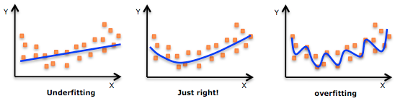
OVERCOMING OVERFIT USING REGULARIZATION

Slide 15
OVERCOMING OVERFIT USING REGULARIZATION
One of the most common mechanisms for avoiding overfit is called regularization.
It constrains the machine learning algorithm to improve out-of-sample error, especially when noise is present.
OLS works well when number of observation n is bigger than the number of predictors p, i. e. n p.
If n ≈ p, overfitting results into low accuracy on unseen observations If n < p, variance of estimates is infinite and OLS fails.
As a remedy, one can identify only relevant variables by feature selection.

Slide 16
RIDGE REGRESSION
Ridge regression is an extension for linear regression. It’s basically a regularized linear regression model. The λ parameter is a scalar that should be learned as well, using a method called cross validation that will be discussed in another post.
A super important fact we need to notice about ridge regression is that it enforces the β coefficients to be lower, but it does not enforce them to be zero. That is, it will not get rid of irrelevant features but rather minimize their impact on the trained model.

Slide 17
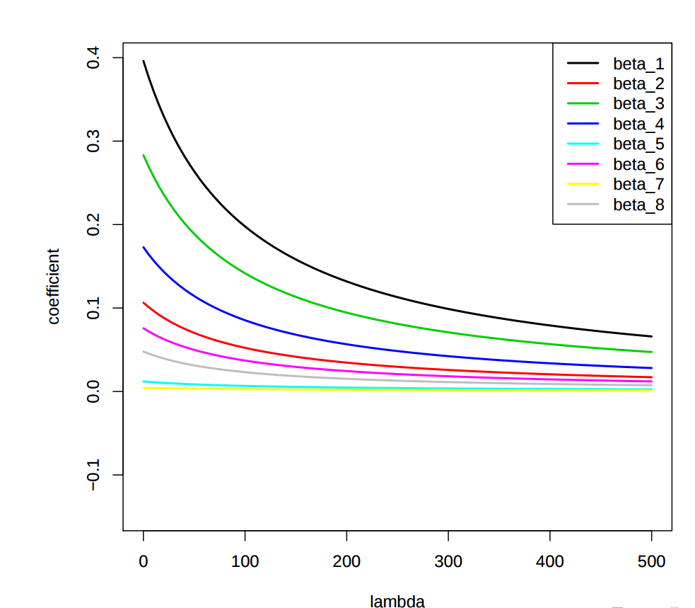
RIDGE REGRESSION

Slide 18
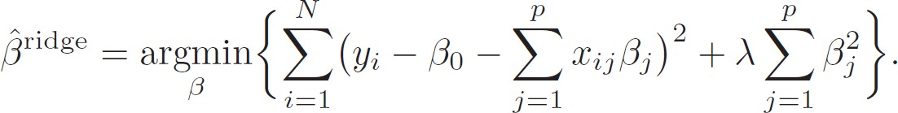
RIDGE REGRESSION
Ridge regression shrinks the regression coefficients by imposing a penalty on their size.
The ridge coefficients minimize a penalized residual sum of squares:
Loss
Penalty

Slide 19
RIDGE REGRESSION
Writing this criterion in matrix form we have:
Then the ridge regression solutions is:

Slide 20
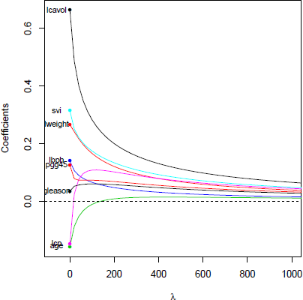
Ridge Regression
β Ridge coefficient paths
in prostate cancer data example:
Ridge regression can have better prediction error than linear regression in a variety of scenarios, depending on the choice of λ.

Slide 21
What is Ridge regression used for?
Ridge Regression is a technique for analyzing multiple regression data that suffer from multicollinearity. ... By adding a degree of bias to the regression estimates, ridge regression reduces the standard errors. It is hoped that the net effect will be to give estimates that are more reliable.

Slide 22
EXAMPLE
Predicting salaries of U. S. baseball players based on game statistics Loading data Hitters
library(ISLR) # Hitters is located inside ISLR
data(Hitters)
Hitters <- na.omit(Hitters) # salary can be missing
Loading package glmnet which implements ridge regression library(glmnet)
Main function glmnet(x, y, alpha=0) requires dependent variable y and regressors x
Function only processes numerical input, whereas categorical variables needs to be transformed via model.matrix(...)

Slide 23
EXAMPLE
Prepare variables
set.seed(0)
# drop 1st column with intercept (glmnet has already one)
x <- model.matrix(Salary ~ ., Hitters)[, -1]
y <- Hitters$Salary train_idx <- sample(nrow(x), size=0.9*nrow(x)) x.train <- x[train_idx, ]
x.test <- x[-train_idx, ]
y.train <- y[train_idx]
y.test <- y[-train_idx]
Call ridge regression and automatically test a sequence of λ
lm.ridge <- glmnet(x.train, y.train, alpha=0)

Slide 24
EXAMPLE
coef(...) retrieves coefficients belonging to each λ
dim(coef(lm.ridge))
## [1] 20 100
→ here: 100 models with different λ and each with 20 coefficients I For example, the 50th model is as follows
lm.ridge$lambda[50] # tested lambda value
## [1] 2581.857
head(coef(lm.ridge)[,50]) # estimated coefficients
## (Intercept) AtBat Hits HmRun Runs
## 211.76123020 0.08903326 0.37913073 1.21041548 0.64115228
## RBI
## 0.59834311

Slide 25
EXAMPLE
plot(model, xvar="lambda") investigates the influence of λ on the estimated coefficients for all variables plot(lm.ridge, xvar="lambda") 4 6 8 10 12 −150 −100 −50 0 50 Log Lambda Coefficients 19 19 19 19 19 I Bottom axis gives lnλ, top the number of non-zero coefficients

Slide 26
Parameter Tuning
REGULARIZATION: RIDGE REGRESSION
plot(cv.model) compares the means squared error across λ
plot(cv.ridge)
19 19 19 19 19 19 19 19 19
220000
●●
●●●●●
●●●●●●
●●●●●●
●●●
●●
●●
●●
●●
●●
●●
160000
●
●
●
●
●
●
●
●
●
●
●
●
●●
●●
●●
●●
●●
●●●●●
●●●●●●●●●●●●●●●●●●●●●●●●●●●
●●●●●●●●●●
100000
4
6 8 10
12
log(Lambda)
Mean squared error first remains fairly constant and then rises sharply

Slide 27
Ridge Regression in R
REGULARIZATION: RIDGE REGRESSION
predict(model, newx=x, s=lambda) makes predictions for new data x and a specific λ
pred.ridge <- predict(cv.ridge, newx=x.test, s="lambda.min")
head(cbind(pred.ridge, y.test))
## |  | 1 | y.test
## | -Alan Ashby | 390.1766 | 475.000
## | -Andre Dawson | 1094.5741 | 500.000
## | -Andre Thornton | 798.5886 | 1100.000
## | -Alan Trammell | 893.8298 | 517.143
## | -Barry Bonds | 518.9105 | 100.000
## | -Bob Dernier | 353.4100 | 708.333
Mean absolute percentage error (MAPE)
mean(abs((y.test - pred.ridge)/y.test))
## [1] 0.6811053

Slide 28
SCALING OF ESTIMATES
OLS estimation
Recall: least square estimates are scale equivalent
Multiplying x_{j} by c ⇒ scaling of β_{j} by a factor 1/c
Ridge regression
In contrast, coefficients in ridge regression can change substantially when scaling variable x_{j} due to penalty termBest is to use the following approach
1 Scale variables via
x_{ij}
x˜ =
.
ij
n
1
(x − x¯ )
2
∑ ij j
^{n} i =1
which divides by the standard deviation of x_{j}
2 Estimate the coefficients of ridge regression
glmnet scales accordingly, but returns coefficients on original scale

Slide 29
BIAS-VARIANCE TRADE-OFF
Ridge regressions benefits from bias-variance trade-off
As λ increases, the flexibility of ridge regression coefficients decreases
→ This Decreases variance but increases bias
60
Mean Squared Error
50
40
10 20 30
0
₁₀–1
10¹ 10³
λ
Squared bias (in black), variance (blue), and error on test set (red)
Dashed line is minimum possible mean squared error

Slide 30
PROS AND CONS OF RIDGE REGRESSION
Advantages
Ridge regression can reduce the variance (with an increasing bias)
→ works best in situations where the OLS estimates have high variance
Can improve predictive performance
Works in situations where p < n
Mathematically simple computations
Disadvantages
Ridge regression is not able to shrink coefficients to exactly zero
As a result, it cannot perform variable selection
⇒ Alternative: Least Absolute Shrinkage and Selection Operator (LASSO)

Slide 31
LASSO REGRESSION
Least Absolute Shrinkage and Selection Operator (LASSO)
Ridge regression always includes p variables, but LASSO performs variables selection
LASSO only changes the shrinkage penalty
n
p p
^{β} LASSO ^{= min} ∑
y_{i} − β₀ − ∑ β_{j} x_{ij} + λ ∑|β |_{j}
Σ₂
β
i =1 j =1
j =1
s x
R˛S¸S shr^{s}inkag˛e¸pen^{x}alty
Here, the LASSO uses the L₁-norm ǁβ ǁ = ∑|β_{j} |
1
j
This penalty allows coefficients to shrink towards exactly zero
LASSO usually results into sparse models, that are easier to interpret

Slide 32
LASSO Regression in R
Implemented in glmnet(x, y, alpha=1) as part of the glmnet package
lm.lasso <- glmnet(x.train, y.train, alpha=1)
Note: different value for alpha
plot(...) shows how λ changes the estimated coefficients
plot(lm.lasso, xvar="lambda")
17 17 12 6
50
0
−100 −50
−2
0
2
4
24
Log Lambda

Slide 33
Parameter Tuning
REGULARIZATION: LASSO REGRESSION
cv.glmnet(x, y, alpha=1) determines optimal λ via cross validation by minimizing the mean squared error from a prediction
set.seed(0)
cv.lasso <- cv.glmnet(x.train, y.train, alpha=1)
Optimal λ and corresponding coefficients ("." are removed variables)
cv.lasso$lambda.min
## [1] 2.143503
head(coef(cv.lasso, s="lambda.min"))
## 6 x 1 sparse Matrix of class "dgCMatrix" ## 1
## (Intercept) 189.7212235
## AtBat -1.9921887
## Hits 6.6124279
## HmRun 0.6674432
## Runs .
## RBI .

Slide 34
Parameter Tuning
REGULARIZATION: LASSO REGRESSION
Total variables
nrow(coef(cv.lasso))
## [1] 20
Omitted variables
dimnames(coef(cv.lasso, s="lambda.min"))[[1]][which(
coef(cv.lasso, s="lambda.min") == 0)]
## [1] "Runs" "RBI" "CAtBat" "CHits"
Included variables
dimnames(coef(cv.lasso, s="lambda.min"))[[1]][which(
coef(cv.lasso, s="lambda.min") != 0)]
## [1] "(Intercept)" "AtBat"
"Hits" "CRuns" "PutOuts"
"HmRun" "CRBI"
## [6] "Years"
## [11] "LeagueN"
## [16] "NewLeagueN"
"CHmRun" "DivisionW"
"Assists"

Slide 35
Parameter Tuning
REGULARIZATION: LASSO REGRESSION
plot(cv.model) compares the means squared error across λ
plot(cv.lasso)
18 18 16 14 12 10 8 6 5 4
100000 140000 180000 220000
●
●
●
●
●
●
●
●
●
●
●
●
●
●
●●●
●●●●●
●●●●●●●●●●●●●●●●●
●●●●●●
●●●●●●●●●●●
●●●●
●●
●
●●●●●●●●
−1 0
1
2 3
log(Lambda)
4
5
Mean squared error first remains fairly constant and then rises sharply
Top axis denotes the number of included model variables

Slide 36
LASSO REGRESSION IN R
predict(model, newx=x, s=lambda) makes predictions for new data x and a specific λ
pred.lasso <- predict(cv.lasso, newx=x.test, s="lambda.min")
Mean absolute percentage error (MAPE) of LASSO
mean(abs((y.test - pred.lasso)/y.test))
## [1] 0.6328225
For comparison, error of ridge regression
## [1] 0.6811053

Slide 37
PROBLEM FORMULATION
REGULARIZATION: COMPARISON
Both ridge regression and LASSO can be rewritten as:
n p
Σ₂
p
β = min ∑ y_{i} − β₀ − ∑ β_{j} x_{ij}
∑ j
2
s. t.
β ≤ θ
ridge
β
i =1
j =1
j =1
s .
_{Σ}x
R˛S¸S
n
p
2
p
^{β} LASSO ^{= min} ∑
y_{i} − β₀ − ∑ β_{j} x_{ij}
∑|β_{j} | ≤ θ
s. t.
β
i =1
j =1
j =1
s
x
R˛S¸S
Outlook: both ridge regression and LASSO have Bayesian formulations

Slide 38
VARIABLE SELECTION WITH LASSO
Comparison of previous constraints
Ridge regression
LASSO
|β₁| + |β₂| ≤ θ
2 2
β + β ≤ θ
1
2
^{β}2
^{β}OLS
β2
βOLS
^{β}ridge
βLASSO
^{β}1
β1
Objective function RSS as contours in red
Constraints (blue) in 2 dimensions
Intersection occurs at β₁ = 0 for LASSO

Slide 39
CASE STUDY
Example
Comparison to OLS estimator
lm.ols <- lm(y.train ~ x.train)
# Workaround as predict.lm only accepts a data.frame
pred.ols <- predict(lm.ols, data.frame(x.train=I(x.test)))
mean(abs((y.test - pred.ols)/y.test)) ## [1] 0.6352089
Comparison
OLS Ridge regression LASSO 0.64 0.68 0.63
Here: LASSO can outperform OLS with fewer predictors

Slide 40
LASSO REGRESSION
Lasso is another extension built on regularized linear regression, but with a small twist. The loss function of Lasso is in the form:
L = ∑( Ŷ_{i}– Y_{i})² + λ∑ |β|
The only difference from Ridge regression is that the regularization term is in absolute value. But this difference has a huge impact on the trade-off we’ve discussed before. Lasso method overcomes the disadvantage of Ridge regression by not only punishing high values of the coefficients β but actually setting them to zero if they are not relevant. Therefore, you might end up with fewer features included in the model than you started with, which is a huge advantage.

Slide 41
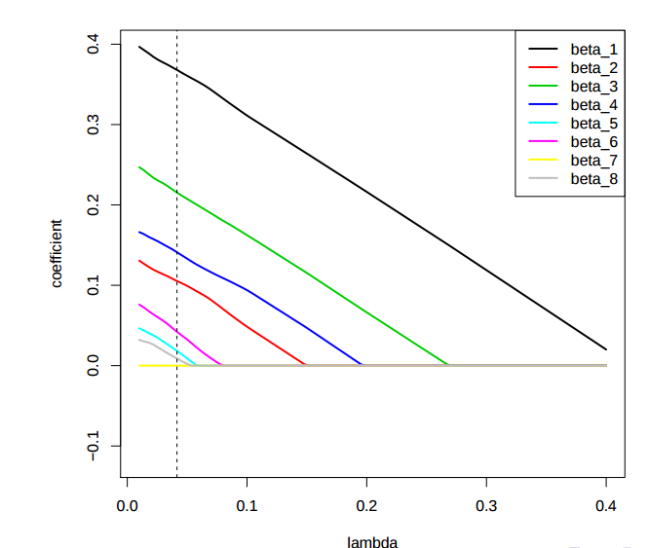
LASSO REGRESSION

Slide 42
LASSO REGRESSION
To Lasso there is no closed form expression to compute β as in ridge regression.
To compute the Lasso solution we have to solve a quadratic programming problem.
However, efficient algorithms are available for computing the entire path of solutions as λ is varied.

Slide 43
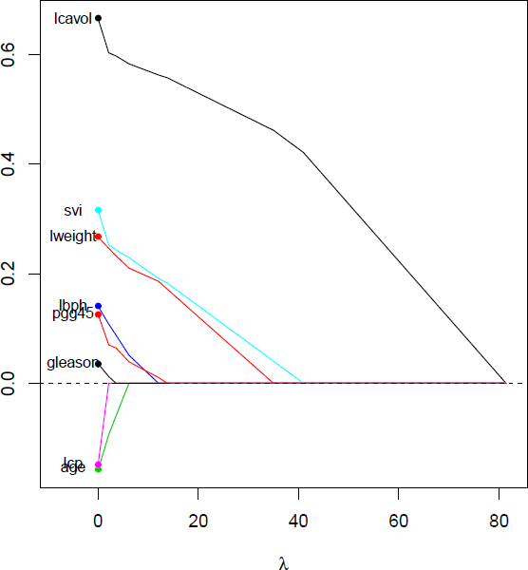
LASSO REGRESSION
The Lasso substantially different from ridge regression: it is able to perform variable selection in the linear model.
As λincreases, more coefficients are set to zero then less variables are selected.
β Lasso coefficient paths
in prostate cancer data example:

Slide 44
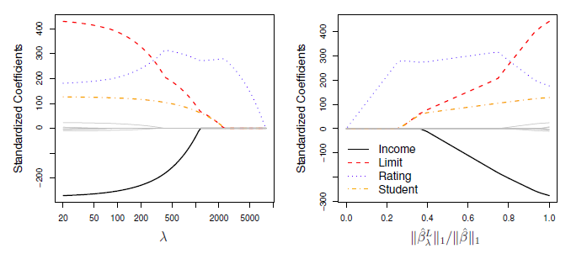
The Lasso (cont.)
When λ = 0, then the lasso simply gives the OLS fit.
When λ becomes sufficiently large, the lasso gives the null model in which all coefficient estimates equal zero.

Slide 45
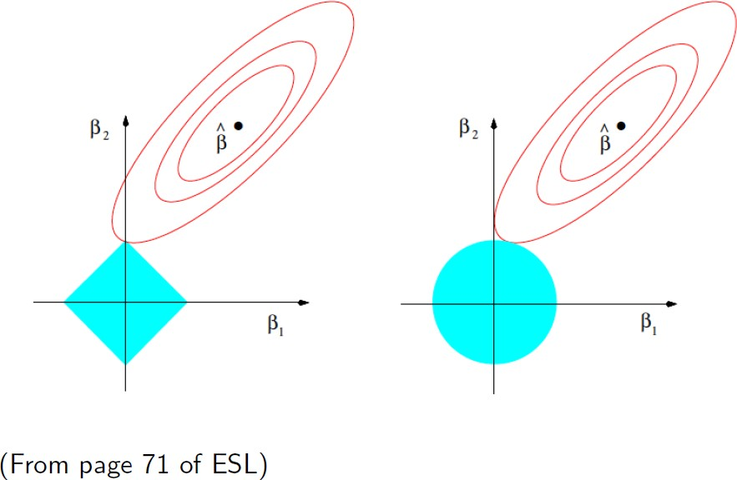
WHY DOES THE LASSO GIVE ZERO COEFFICIENTS?
Lasso
Ridge

Slide 46
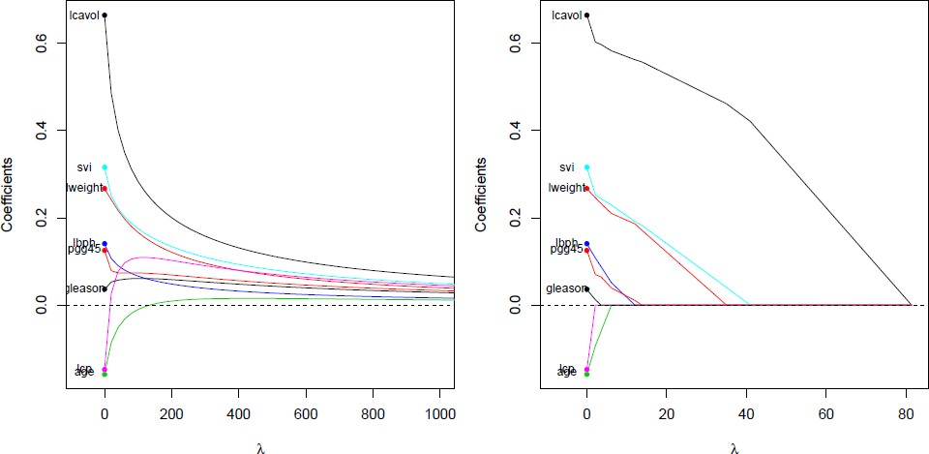
LASSO ADVANTAGE IN INTERPRETATION
Lasso is competitive with Ridge regression in terms of this prediction error.
Lasso has a big advantage with respect to interpretation.
This is because Lasso sets coefficients exactly to zero, i.e., Lasso performs variable selection in the linear model generating sparse models.
RIDGE
LASSO

Slide 47
LASSO ADVANTAGE IN INTERPRETATION
Here the turning factor λ controls the strength of penalty, that is
When λ = 0: We get same coefficients as simple linear regression
When λ = ∞: All coefficients are zero
When 0 < λ < ∞: We get coefficients between 0 and that of simple linear regression
So when λ is in between the two extremes, we are balancing the below two ideas.
1. Fitting a linear model of y on X
2. Shrinking the coefficients
But the nature of L1 regularization penalty causes some coefficients to be shrunken to zero. Hence, unlike ridge regression, lasso regression is able to perform variable selection in the liner model. So as the value of λ increases, more coefficients will be set to value zero (provided fewer variables are selected) and so among the nonzero coefficients, more shrinkage will be employed. The below working example will explain it well.

Slide 48
WORKING EXAMPLE
For analyzing the prostate-specific antigen and the clinical measures among the patients who were about to have their prostates removed, ridge regression can give good results provided there are a good number of true coefficients. But if there are only a few coefficients to predict the results lasso regression is the better option to have accurate results since lasso can perform better than ridge when the coefficients are few.

Slide 49
THANK YOU

